Slide 1
Gen AI and Langchain Basics
Instructor Lead Session-1

Slide 2
Agenda
01
Introduction to Transformers
02
Language Models & Market Overview
03
Prompt Engineering
04
Langchain Ecosystem & Basic Chatbot
05
Langchain Core Concepts
06
Real - Time use case (Langchain)

Slide 3
Introduction to Transformers

Slide 4
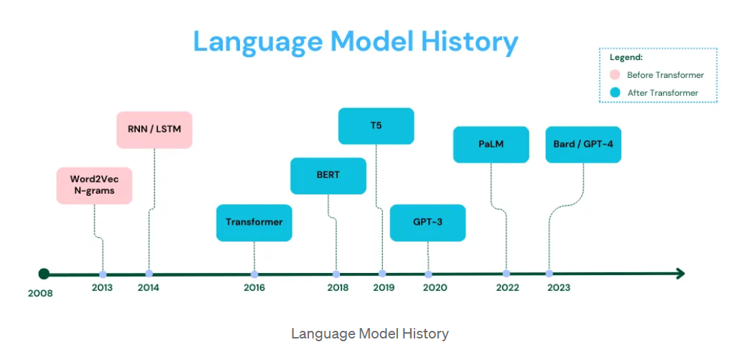

Slide 5

Transformers
Transformers are a type of deep learning model introduced by Vaswani et al. in the groundbreaking paper "Attention is All You Need" (2017). Unlike previous models such as RNNs and LSTMs, transformers rely entirely on a mechanism called self-attention, allowing them to process entire sequences of input data simultaneously. Key Components of a Transformer:
Self-Attention: Helps the model focus on relevant parts of the input when producing an output. For example, in translating "She ate the apple because it was sweet", the model learns that "it" refers to "apple".
Positional Encoding: Since transformers don’t have recurrence, they use positional encoding to understand the order of tokens in a sequence.
Multi-Head Attention: Allows the model to focus on different words in different ways (semantics, syntax, etc.) simultaneously.
Feedforward Networks: Adds non-linear transformation for better representation learning.
Layer Normalization & Residual Connections: Helps in stabilizing training and allows deeper networks.
Architecture Types:
Encoder-Decoder: The encoder processes input (e.g., English sentence), and the decoder generates output (e.g., translated French sentence). Used in T5, BART, and translation systems.
Encoder-Only: These models understand text. BERT is a classic example used for sentence classification, sentiment analysis, and search.
Decoder-Only: These models are focused on generating text based on a given prompt. GPT-2 and GPT-4 are well-known examples..

Slide 6
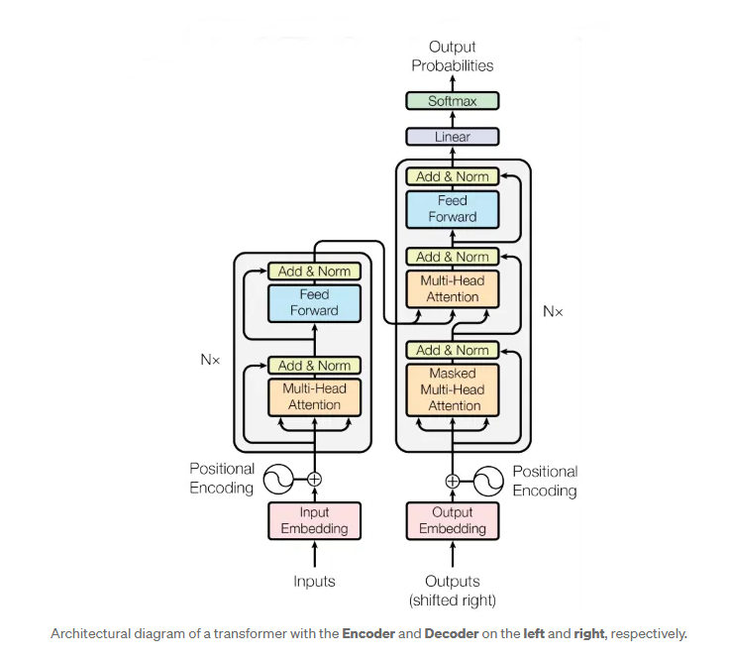
Transformers
Encoder
6 layers with self-attention + feed-forward blocks.
Uses residual connections + layer normalization.
Captures full input context simultaneously.
Decoder
6 layers with masked self-attention, cross-attention, and feed-forward.
Applies masking to prevent peeking at future tokens.
Attends to both past outputs and encoder’s context.
Self-Attention
Each word attends to every other word in the input.
Learns relationships (e.g., “it” → “apple”).
Foundation for context-aware understanding.
Multi-Head Attention
Runs multiple attention layers in parallel.
Captures diverse linguistic patterns.
Outputs merged for richer understanding.

Slide 7
Language Models
&
Market Overview

Slide 8
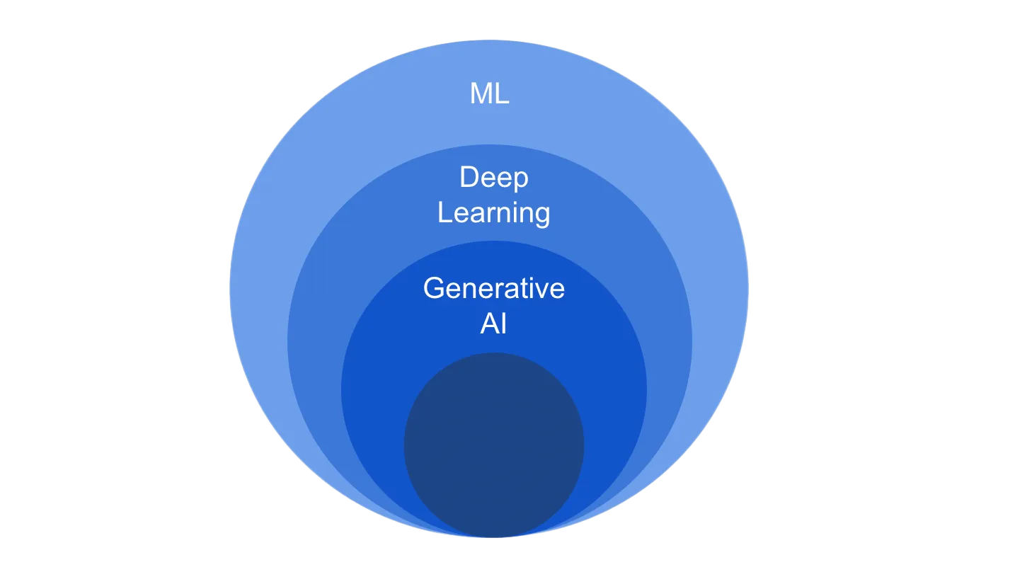
Language Models
What are Language Models?
LMs predict the next word based on context (e.g., "The cat sat on the ___").
LLMs are scaled-up LMs with billions of parameters, capable of answering questions, generating text, and reasoning.
SLMs are optimized small models for faster, cheaper, on-device usage.
Generative AI
Generative AI is a subset of deep learning, which means it uses artificial neural networks to process both unlabeled and labeled data using supervised, unsupervised and semi-supervised learning.
How to evaluate Generative AI Models?
Quality: Having quality generation output is key, especially for applications that interact directly with users
Diversity: A good generative model captures the minority modes in its data distribution without sacrificing generation quality
Speed: Many interactive applications require fast generation, such as real-time image editing to allow use in content creation workflow.

Slide 9
Popular Generative AI Language Models
Model | Parameters | Reasoning | Code Gen | Public Access
GPT-4 | ~1T+ (est.) | Strong | Strong | ChatGPT (paid)
Claude 3 Opus | ~200B+ | Strong | Good | Claude.ai
Gemini 1.5 Pro | Unknown | Strong | Strong | Google AI Studio
LLaMA 3 70B | 70B | Good | Moderate | Open-source
Mistral 7B | 7B | Fair | Good | Open-source
Phi-2 | 2.7B | Limited | Basic | Open-source

Slide 10
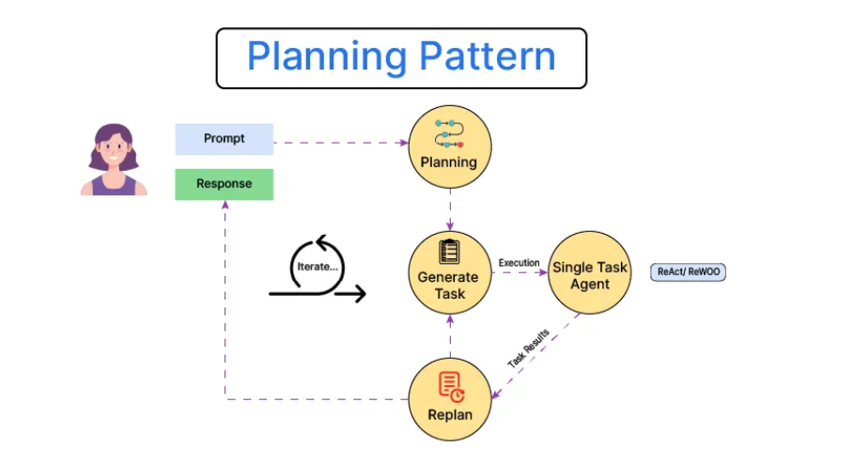

Slide 11
Prompt Engineering

Slide 12
Prompt Engineering
Prompt engineering is the process of crafting effective input instructions to guide AI models like Chat GPT to produce the desired output. Just like asking a human assistant, the way you phrase your request influences the quality and relevance of the response.
Think of it as giving clear directions to a super-smart assistant.
Small tweaks in wording can drastically improve results.
Widely used in systems like ChatGPT, Siri, and Alexa.
Prompting Techniques:
Zero-Shot Prompting: Ask directly without prior examples - "Generate a project status summary from the following task updates."
Few-Shot Prompting: Provide 2–3 examples before asking the model to generalize - "Client A: 'Need refund' → Intent: Refund Client B: 'Want money back' → Intent: Refund Client C: 'Package missing' → Intent: ?"
Chain of Thought (CoT): Prompt the model to explain its reasoning step-by-step - "The client mentioned they ordered yesterday, selected same-day delivery, and haven’t received it. Should it be marked as delayed? Explain why."

Slide 13
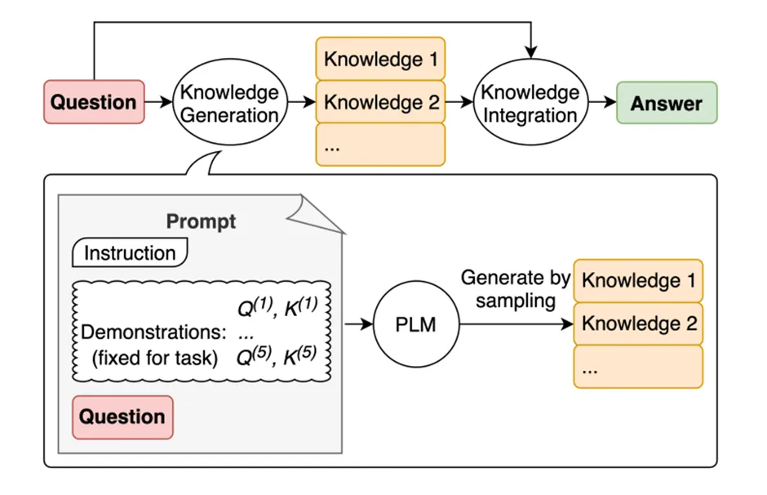
Elements of a prompt
A prompt can include different elements:
Instruction - It’s a specific task or direction for the model to follow.
Context - It provides extra information or context to help the model generate better responses.
Input Data - It refers to the question or input for which we want the model to provide a response.
Output Indicator - It indicates the desired type or format of the output.
Not all four elements are necessary for a prompt, and the format depends on the specific task being performed.
The diagram illustrates how modern prompting techniques integrate external knowledge to improve LLM responses.
Knowledge Generation: When a question is asked, the model generates multiple relevant knowledge snippets (facts, examples, references).
Prompt Construction: A structured prompt is created with an instruction, example demonstrations, and the question.
Knowledge Sampling: The Pretrained Language Model (PLM) samples and generates relevant knowledge pieces.
Knowledge Integration: All retrieved/generated knowledge is synthesized to form a coherent, accurate answer.

Slide 14
Introduction to Langchain
&
Core concepts

Slide 15
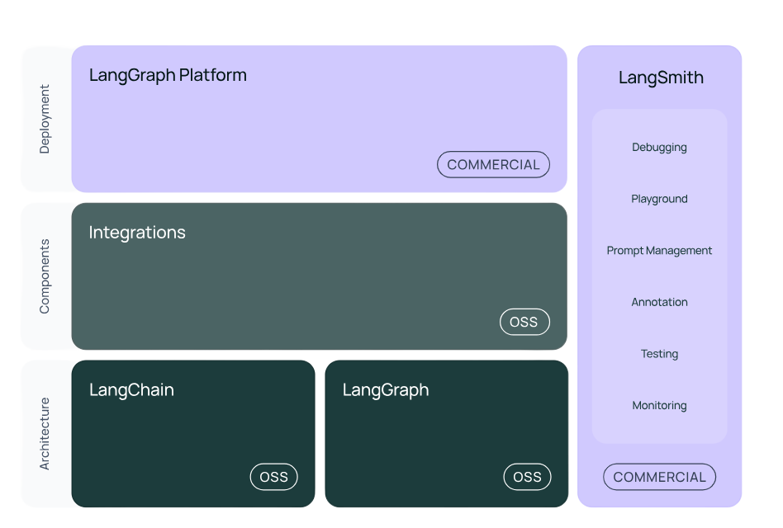
What is Langchain?
LangChain is an open-source framework designed to make it easier to build applications powered by language models. It abstracts away common complexities and provides plug-and-play components to integrate models, data sources, memory, tools, and logic into a coherent pipeline.
Originally built in Python, now also supports JavaScript/TypeScript.
Ideal for creating chatbots, agents, RAG (retrieval-augmented generation) systems, and automation tools.
Encourages modularity, flexibility, and scalability.
LangChain simplifies the process of:
Prompt engineering and chaining prompts together.
Connecting LLMs with external APIs, databases, or file systems.
Managing conversation history and context across multiple turns.
Architecture Layer:
LangChain: Core open-source library for chaining LLM calls with prompts, tools, memory, etc.
LangGraph: Adds stateful agent workflows using a graph-based approach (ideal for multi-step reasoning).
Component Layer:
Integrations: Prebuilt connectors for LLMs, vector DBs, document loaders, embeddings, and more. Open source (OSS).
Deployment Layer:
LangGraph Platform: Commercially hosted environment for managing and deploying agentic workflows.
LangSmith (Commercial Tooling): Provides UI for debugging, testing, monitoring, and managing prompts.
Together, this stack enables production-ready, maintainable GenAI applications.

Slide 16
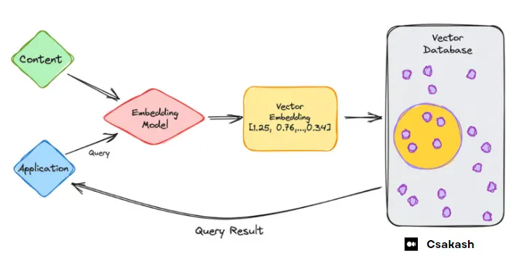
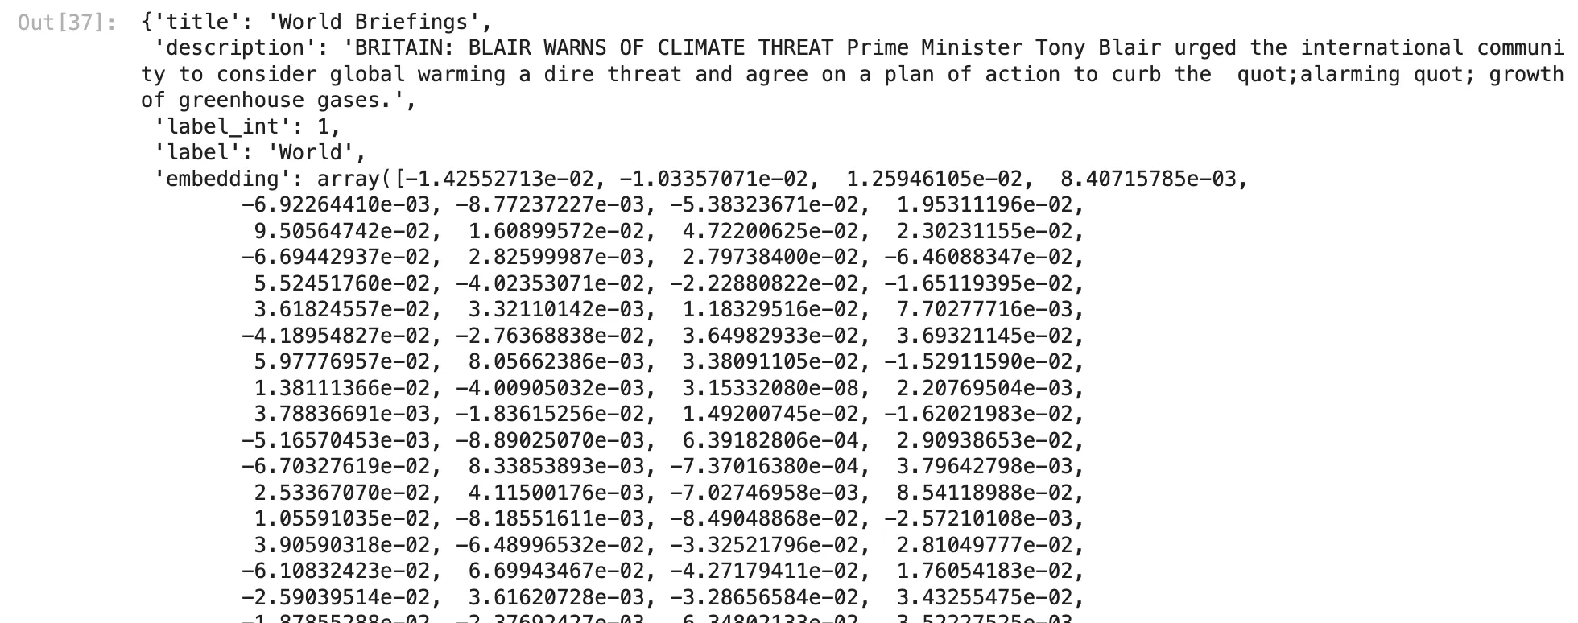
Embeddings, Vector DBs & Semantic Search
Vector Embeddings
Embeddings are numerical vector representations of text that capture semantic meaning.
Words, phrases, or documents with similar meanings have similar vector representations.
Generated using models like OpenAIEmbeddings, HuggingFaceEmbeddings, or InstructorEmbedding.
Convert customer reviews to vectors and find similar sentiments or complaints.
Vector Databases:
Databases specifically designed to store and search large collections of embeddings.
They support approximate nearest neighbor (ANN) search to retrieve top-k similar vectors.
Examples: FAISS (local), Chroma (Python-native), Pinecone, Weaviate, Milvus.
Store knowledge chunks from enterprise PDFs and retrieve relevant answers on query.

Slide 17
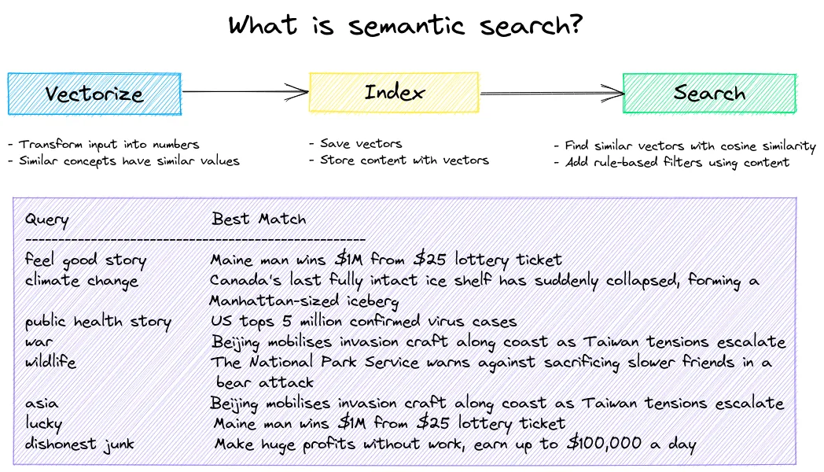
Chunking:
Breaking long documents into smaller overlapping parts so they fit within token limits.
Improves semantic relevance and retrievability.
Types of Chunking:
Fixed-size chunking: Based on token/word count (e.g., 200 tokens with 20 overlap).
Recursive/semantic chunking: Splits by sections, headings, or meaning.
Sliding window chunking: Rolling window that generates overlapping sequences.
Splitting 20-page contracts for efficient question-answering.
Semantic Search:
Uses vector similarity instead of keyword matching to retrieve relevant content.
Ideal when users don’t phrase queries exactly as in the source.
Enables Agentic RAG (Retrieval-Augmented Generation):
Query → Embedding → Top K Chunks → LLM → Answer
RAG Agents can reason over documents, chain multiple calls, and cite sources.
(Embeddings + Chunking + Vector DB + RAG) forms the foundation of LLM-powered search engines and enterprise knowledge assistants.

Slide 18
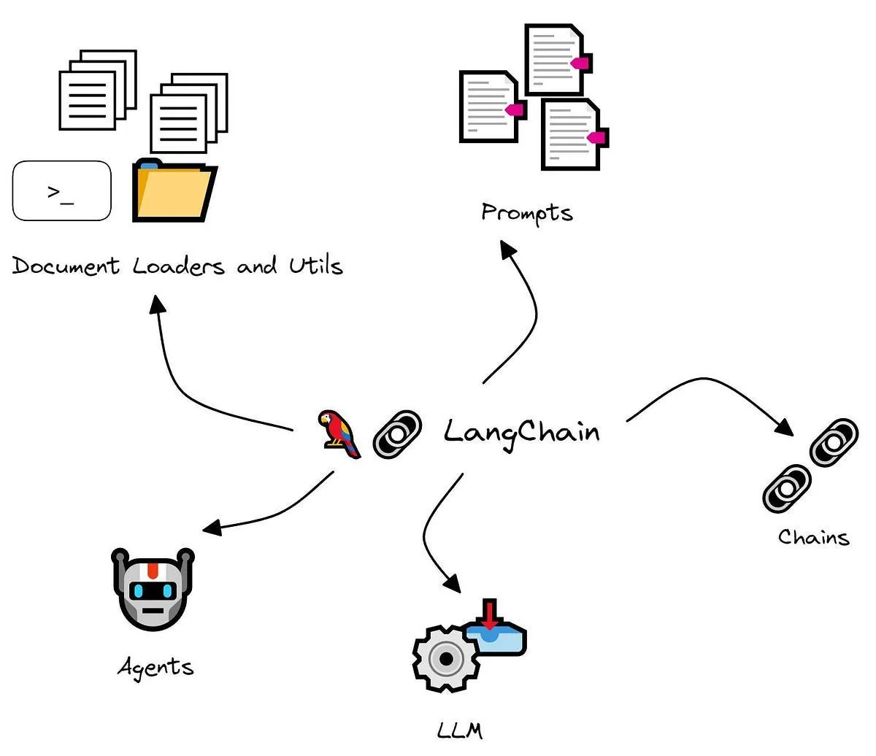
Langchain Core Concepts
Document Loaders & Chunking
Document loaders (PDF, DOCX, CSV, etc.) enable ingestion of real-world enterprise data.
Chunking splits documents into overlapping text blocks to stay within context length.
Chunking improves retrievability and coherence of responses in long-context use cases.
Retrievers
Retrievers accept a string query and return relevant documents from a source (e.g., PDFs, websites).
Can be built over vector DBs or APIs like Wikipedia, Google Search, or Amazon Kendra.
Help models ground their responses in real documents, improving factual accuracy.
Tools
Tools are functions or APIs callable by the LLM agent.
Examples: calculator, SQL query runner, web search, or weather APIs.
Tools make LLMs more action-oriented and capable of multi-hop reasoning.
Vector Stores & Embeddings
Text is converted to vector form using models like OpenAI Embeddings or Hugging Face Embeddings.
Vector DBs (e.g., FAISS, Chroma, Pinecone) store these embeddings for semantic search.
Enables Retrieval-Augmented Generation (RAG) by fetching similar chunks based on user query.
Output Parsers
Output parsers convert unstructured model output into structured formats (like JSON or Python classes).
Common parsers: PydanticOutputParser, StructuredOutputParser, and CommaSeparatedListOutputParser.
Business Need: Extract structured insights like invoice totals, named entities, or classifications.

Slide 19
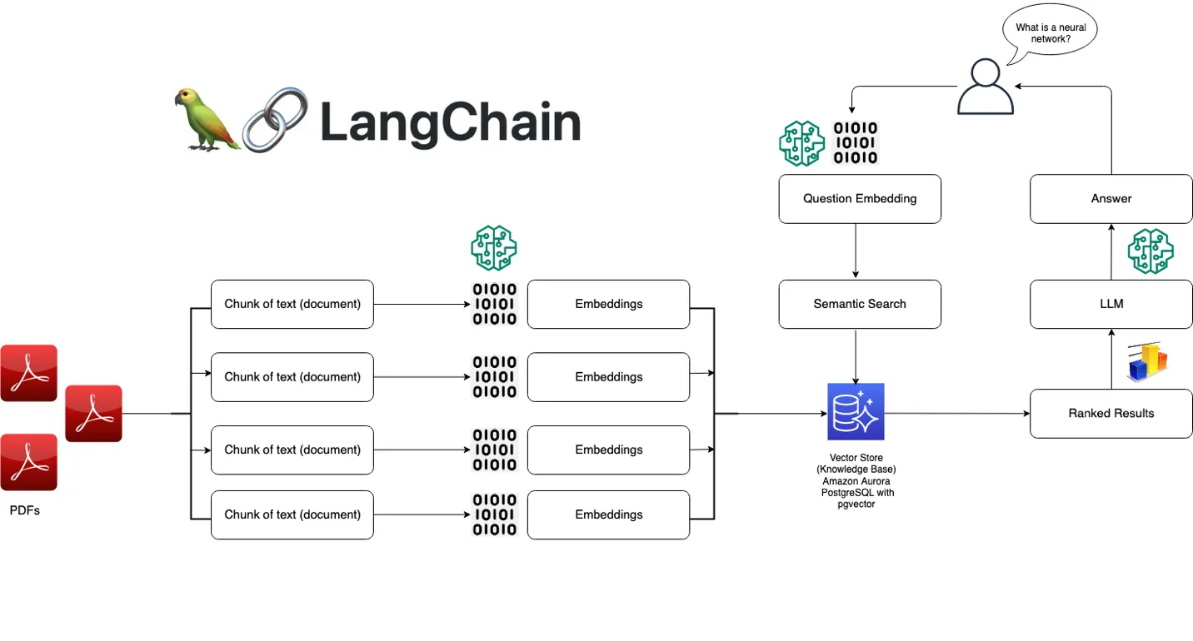
Memory & Chat History
Memory components (Conversation Buffer Memory, Summary Memory) retain chat context.
Allows users to reference earlier queries, enabling true dialogue.
Critical in support bots, tutoring systems, or interactive dashboards.
Multimodality
New-gen chat models can now handle images, audio, and video alongside text.
Useful for enterprise dashboards, document understanding (image-based tables), and voicebots.
Examples: GPT-4o, Gemini, and Claude 3 Opus.
Chat Models are advanced language models optimized for handling message-based interactions. Unlike traditional completion-based models, chat models take structured message inputs and return message outputs.
They support advanced features like:
Tool/Function Calling: Enable LLMs to trigger external functions like fetching data, executing SQL queries, or calling APIs.
Streaming Responses: Useful for live typing experiences in chat UIs.
Structured Output: Can return well-defined formats like JSON using output parsers.
Few-Shot + Instruction Formatting: Models can be primed with examples and customized instructions.
Token & Metadata Tracking: Analyze cost and latency across providers.
These make chat models ideal for building production-grade conversational agents, AI copilots, and tool-using assistants
Langchain Core Concepts
Feature | Real Use Case
Output Parser | Extracting payment info from chatbot invoices
Retriever | HR bot retrieving company policy answers
Memory | AI tutor recalling student’s learning progress
Tools | Agent calling API to book meeting or retrieve stock price
Multimodal | Upload image and get insights from charts/tables

Slide 20
Thank You

